Slide 1
RSM222 Class 8- Planning and Control: Standard Cost & Variance Analysis
Elisa Zuliani

Slide 2
Learning Objectives
Describe standard costs.
Compute direct materials price and quantity variances.
Compute direct labor rate and efficiency variances.
Compute variable manufacturing overhead spending and efficiency variances.
Compute and interpret the fixed overhead budget and volume variances.
Prepare variance reports.

Slide 3
Standard Costs
Standards are benchmarks or “norms” for measuring performance. Two types of standards are commonly used:
Quantity standards specify how much of an input should be used to make a product or provide a service.
Cost (price) standards specify how much should be paid for each unit
of the input.
How much of an input should be used in the production of X
How much should be paid for each unit of input.

Slide 4
Standard Costs
Deviations from standards deemed significant are brought to the attention of management, a practice known as management by exception.
Standard
Amount
Direct Material
Direct Labour
Manufacturing Overhead
Type of Product Cost

Slide 5
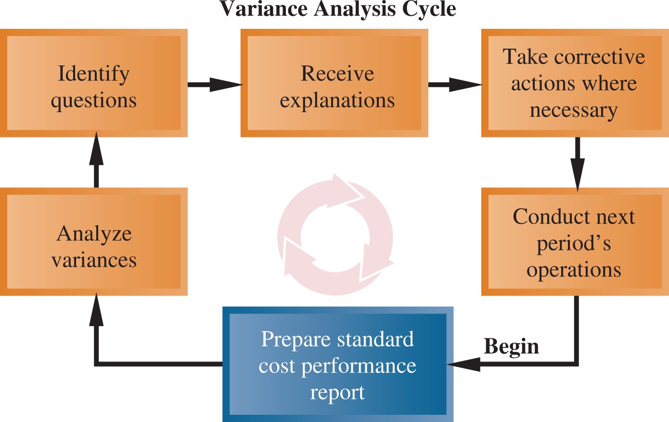
Variance Analysis Cycle
Exhibit 10-1

Slide 6
Standards vs. Budgets
Both standards and budgets are predetermined costs, and both contribute to management planning and control.
There is a difference:
A standard is a unit amount.
A standard is a per unit cost
A budget is a total amount.
A standard can be viewed as the budgeted cost for one unit of product

Slide 7
Setting Standard Costs
Setting standard costs requires input from all persons who have responsibility for costs and quantities.
Standards should change whenever managers determine that the existing standard is not a good measure of performance.
Allow for no machine breakdowns or other work interruptions
require peak efficiency all the time.
IDEAL STANDARDS
Allow for normal machine downtime and other work interruptions
can be attained through reasonable efforts by the average employee.
PRACTICAL STANDARDS
When would each be relevant?

Slide 8
Setting Direct Material Standards
Standard Price
per Unit
Standard Quantity
per Unit
Final, delivered cost of materials, net of discounts including
shipping, receiving, and other such costs.
The amount of material required for each unit,
as well as an allowance for unavoidable waste, spoilage, and other normal inefficiencies.

Slide 9
Setting Direct Labour Standards
Standard Rate
per Hour
Standard Hours
per Unit
The labour rate that should be incurred per hour of labour time, including Employment Insurance, employee benefits, and other labour costs.
Use time and
motion studies for each labour operation to
determine the amount of labour
time to complete one unit.
Should include allowance for normal inefficiencies.

Slide 10
Setting Variable Overhead Standards
Price Standards
Quantity Standards
The rate is the variable portion of the
predetermined overhead
rate.
The quantity is the
activity in the allocation base used to calculate the predetermined overhead.
For manufacturing overhead, companies use a standard predetermined overhead
rate in setting the standard.
Overhead rate is determined by dividing budgeted overhead costs by an expected standard activity index, such as standard direct labor hours or standard machine hours.

Slide 11
Variance Analysis
Variance is defined as:
Variance = Actual - Budget
It is the difference between standard and actual prices or standard and actual quantities
Actual costs < Standard costs = Favorable Variance.
Actual costs > Standard costs = Unfavorable Variance.
A variance can result from differences related to the cost of materials, labor, or overhead.

Slide 12
Standard Cost - Variable Production Cost
A standard cost card for one unit of product might look like this:

Slide 13
Why do we Care?
How does this relate to last class?
Formulating long and short-term plans (Planning)
Variances provide warning signs of situations requiring corrective action by managers.
This process of focusing on variances is also known as “management by exception.”
Issues are brought to the attention of management if results represent substantial differences from the budget
Comparing actual to planned performance (Controlling)
Implementing plans (Directing and Motivating)
Decision
Making
Measuring performance (Controlling)

Slide 14
Why do we Care? (cont’d)
Monitoring + Continuous Improvement
Variances need to be reviewed regularly by management and corrective actions should be taken for unfavorable variances.
Can be used to evaluate performance of employees as long as the worker has control/responsibility over the variance being analyzed.
Performance Evaluation

Slide 15
Standards vs. Budgets
Standards and budgets are very similar.
A budget is set for total costs, whereas a standard is a per unit cost.
A standard can be viewed as the budgeted cost for one unit of product.

Slide 16
Price and Quantity Standards
Price and quantity standards are determined separately for two reasons:
The purchasing manager is responsible for raw material purchase prices and the production manager is responsible for the quantity of raw material used.
The buying and using activities occur at different times. Raw material purchases may be held in inventory for a period of time before being required for use in production.

Slide 17
General Model for Variance Analysis
Variance Analysis
Price Variance
Quantity Variance
Difference between actual price and standard price
Difference between actual quantity and standard quantity

Slide 18

General Model for Variance Analysis
Variance Analysis
Price Variance
Quantity Variance
Materials quantity variance
Labour efficiency variance
VOH efficiency variance

Slide 19
General Model for Variance Analysis
Actual Quantity Actual Quantity Standard Quantity × × × Actual Price Standard Price Standard Price
Price Variance
Quantity Variance
Total Flexible Budget Variance

Slide 20
General Model for Variance - 4
Actual quantity is the amount of direct material, direct labour, and variable manufacturing overhead actually acquired.
Actual Quantity Actual Quantity Standard Quantity × × × Actual Price Standard Price Standard Price
Price Variance
Quantity Variance
Total Flexible Budget Variance

Slide 21
General Model for Variance Analyis - 5
Standard quantity is the standard quantity allowed for the actual number of units produced.
Actual Quantity Actual Quantity Standard Quantity × × × Actual Price Standard Price Standard Price
Price Variance
Quantity Variance
Total Flexible Budget Variance

Slide 22
A General Model for Variance Analysis - 6
Actual price is the amount actually paid for amount of the input acquired.
Actual Quantity Actual Quantity Standard Quantity × × × Actual Price Standard Price Standard Price
Price Variance
Quantity Variance
Total Flexible Budget Variance
0-22

Slide 23
General Model for Variance Analysis - 7
Standard price is the amount that should have been paid for the amount of input used.
Actual Quantity Actual Quantity Standard Quantity × × × Actual Price Standard Price Standard Price
Price Variance
Quantity Variance
Total Flexible Budget Variance

Slide 24
General Model for Variance Analysis - 8
(AQ × AP) – (AQ × SP) (AQ × SP) – (SQ × SP)
AQ = Actual Quantity SP = Standard Price AP = Actual Price SQ = Standard Quantity
Actual Quantity Actual Quantity Standard Quantity × × × Actual Price Standard Price Standard Price
Price Variance
Quantity Variance
Total Flexible Budget Variance

Slide 25
Material Variances Example
Glacier Peak Outfitters has the following direct material standard for the fibrefill in its mountain parkas.
0.1 kg. of fibrefill per parka(p) at $5.00 per kg.
Last month 210 kgs of fibrefill were purchased and used to make 2,000 parkas. The material cost a total of $1,029.

Slide 26
Material Variances Summary - 1
Actual Quantity Actual Quantity Standard Quantity × × × Actual Price Standard Price Standard Price
210 kgs. 210 kgs. 200 kgs. × × × $4.90 per kg. $5.00 per kg. $5.00 per kg.
= $1,029 = $1,050 = $1,000
Price variance $21 favourable
Quantity variance $50 unfavourable
$29 unfavourable

Slide 27
Material Variances Summary - 2
Actual Quantity Actual Quantity Standard Quantity × × × Actual Price Standard Price Standard Price
210 kgs. 210 kgs. 200 kgs. × × × $4.90 per kg. $5.00 per kg. $5.00 per kg.
= $1,029 = $1,050 = $1,000
$1,029 ÷ 210 kgs = $4.90 per kg
Price variance $21 favourable
Quantity variance $50 unfavourable
$29 unfavourable

Slide 28
Material Variances Summary - 3
Actual Quantity Actual Quantity Standard Quantity × × × Actual Price Standard Price Standard Price
210 kgs. 210 kgs. 200 kgs. × × × $4.90 per kg. $5.00 per kg. $5.00 per kg.
= $1,029 = $1,050 = $1,000
0.1 kg per parka × 2,000 parkas = 200 kgs
Price variance $21 favourable
Quantity variance $50 unfavourable
$29 unfavourable

Slide 29
Materials Variances: Using Equations
Materials Price variance: variance:
MPV = AQ (AP – SP)
= 210 kgs ($4.90/kg – $5.00/kg)
= 210 kgs (-$0.10/kg)
= $21 F
Materials quantity variance:
MQV = SP (AQ – SQ)
= $5.00/kg (210 kgs – (0.1 kg/p × 2,000p))
= $5.00/kg (210 kgs – 200 kgs)
= $5.00/kg (10 kgs)
= $50 U

Slide 30
Isolation of Material Variances
Variances should be isolated and brought to the attention of management as quickly as possible so that problems can be identified and corrected on a timely basis.
The most significant variances should be viewed as red flags.

Slide 31
Responsibility for Material Variances - 2
The Production Manager is responsible for the Material Quantity Variance.
The standard price is used to compute the quantity variance so that the production manager is not held responsible for the purchasing manager’s performance.
If the purchasing manager purchases cheap material, more of it may need to be used in production causing an unfavourable material quantity variance.

Slide 32
Responsibility for Material Variances - 2
The Purchasing Manager is responsible for the Material Price Variance.
Poor scheduling by the production manager may require the purchasing manager to make rush orders for material at a higher price, causing unfavourable price variances.
Therefore, it is important to know what each manager is responsible for.

Slide 33
Labour Variances Example
Glacier Peak Outfitters has the following direct labour standard for its mountain parka.
0.6 standard hours per parka at $20.00 per hour
Last month, employees actually worked 1,250 hours at a total labour cost of $26,250 to make 2,000 parkas0 parkas.

Slide 34
Labour Variances Example - 2
Actual Hours Actual Hours Standard Hours × × × Actual Rate Standard Rate Standard Rate
1,250 hours 1,250 hours 1,200 hours × × × $21.00 per hour $20.00 per hour $20.00 per hour
= $26,250 = $25,000 = $24,000
Rate variance $1,250 unfavourable
Efficiency variance $1,000 unfavourable
$2,250 unfavourable

Slide 35
Labour Variances Example - 3
Actual Hours Actual Hours Standard Hours × × × Actual Rate Standard Rate Standard Rate
1,250 hours 1,250 hours 1,200 hours × × × $21.00 per hour $20.00 per hour $20.00 per hour
= $26,250 = $25,000 = $24,000
$26,250 ÷ 1,250 hours = $21.00 per hour
Rate variance $1,250 unfavourable
Efficiency variance $1,000 unfavourable
$2,250 unfavourable

Slide 36
Labour Variance Example - 4
Actual Hours Actual Hours Standard Hours × × × Actual Rate Standard Rate Standard Rate
1,250 hours 1,250 hours 1,200 hours × × × $21.00 per hour $20.00 per hour $20.00 per hour
= $26,250 = $25,000 = $24,000
0.6 hours per parks x 2,000 parkas = 1,200 hours
Rate variance $1,250 unfavourable
Efficiency variance $1,000 unfavourable
$2,250 unfavourable

Slide 37
Labour Variances Example - 4
Actual Hours Actual Hours Standard Hours × × × Actual Rate Standard Rate Standard Rate
1,250 hours 1,250 hours 1,200 hours × × × $21.00 per hour $20.00 per hour $20.00 per hour
= $26,250 = $25,000 = $24,000
Rate variance $1,250 unfavourable
Efficiency variance $1,000 unfavourable
$2,250 unfavourable

Slide 38
Labour Variance Using the Equations
Labour rate variance
LRV = AH (AR – SR)
= 1,250 hours ($21.00/hour – $20.00/hour)
= 1,50 hours ($1.00/hour)
= $1,250 unfavourable
Labour efficiency variance
LEV = SR (AH – SH)
= $20.00/hr (1,250 hours – 1,200 hours)
= $20.00/hr (50 hours)
= $1,000 unfavourable

Slide 39
Variable Manufacturing Overhead Variances Example
Glacier Peak Outfitters has the following direct variable manufacturing overhead labour standard for its mountain parka.
0.6 standard hours per parka at $8.00/hour
Last month, employees actually worked 1,250 hours to make 2,000 parkas. Actual variable manufacturing overhead for the month was $10,500.

Slide 40
Variable Manufacturing Overhead Variance Summary 1
Actual Hours Actual Hours Standard Hours × × × Actual Rate Standard Rate Standard Rate
1,250 hours 1,250 hours 1,200 hours × × × $8.40 per hour $8.00 per hour $8.00 per hour
= $10,500 = $10,000 = $9,600
Spending variance $500 unfavourable
Efficiency variance $400 unfavourable
$900 unfavourable

Slide 41
Variable Manufacturing Overhead Variances Summary 2
Actual Hours Actual Hours Standard Hours × × × Actual Rate Standard Rate Standard Rate
1,250 hours 1,200 hours 1,200 hours × × × $8.40 per hour $8.00 per hour $8.00 per hour
= $10,500 = $10,000 = $9,600
$10,500 ÷ 1,250 hours = $8.40 per hour
Spending variance $500 unfavourable
Efficiency variance $400 unfavourable
$900 unfavourable

Slide 42
Variable Manufacturing Overhead Variances Summary 3
Actual Hours Actual Hours Standard Hours × × × Actual Rate Standard Rate Standard Rate
1,250 hours 1,250 hours 1,200 hours × × × $8.4 per hour $8.00 per hour $8.00 per hour
= $10,500 = $10,000 = $9,600
0.6 hours per parka × 2,000 parkas = 1,200 hours
Spending variance $500 unfavourable
Efficiency variance $400 unfavourable
$900 unfavourable

Slide 43
Variable Manufacturing Overhead Variances: Using the Equations
Variable manufacturing overhead spending variance
VMSV = AH (AR – SR)
= 1,250 hours ($8.40/hour – $8.00/hour)
= 1,250 hours ($0.40/hour)
= $500 unfavourable
Variable manufacturing overhead efficiency variance
VMEV = SR (AH – SH)
= $8.00 per hour (1,250 hours – 1,200 hours)
= $8.00 per hour (50 hours)
= $400 unfavourable

Slide 44
Interpreting the Efficiency Variances
This variance is useful only if the cost driver for variable overhead really is the actual hours worked.
This variance is an estimate of the indirect effect on variable overhead costs of efficiency or inefficiency in the use of the activity base.

Slide 45
Standard Costs and Variance in the Service Industry
While standard costing has its roots in the manufacturing industry, standard costing techniques can also help firms in the service industry understand and better manage their costs.
The main differences between standard costing in the manufacturing and service industries are the terminology used and the manner in which the cost of goods sold account is calculated.
10-45

Slide 46
Overhead Rates and Fixed Overhead Analysis
Recall that overhead costs are assigned to products and services using a predetermined overhead rate (POHR):
Assigned Overhead = POHR × Standard Activity
Overhead from the flexible budget for the denominator level of activity
POHR =
Denominator level of activity
10-46

Slide 47
Denominator Activity
The denominator activity is the activity level used to compute the predetermined overhead rate, such as number of machine hours or number of labour hours.
Once an estimated activity level (denominator activity) has been chosen, it remains unchanged throughout the year, even if the actual activity turns out to be different from the original estimate.
10-47

Slide 48
Overhead Rates and Fixed Overhead Analysis
The predetermined overhead rate can be broken down into fixed and variable components.
The variable component is useful for preparing and analyzing variable overhead variances.
The fixed component is useful for preparing and analyzing fixed overhead variances.
10-48

Slide 49
Overhead Application in a Standard Costing System
To understand fixed overhead variances, it is necessary to first understand how overhead is applied to WIP in a standard costing system.
In a normal cost system, overhead is applied to work in process based on the actual number of hours worked in the period.
In a standard cost system, overhead is applied to work in process based on the standard hours allowed for the actual output of the period.
10-49

Slide 50
Normal versus Standard Cost Systems
Exhibit 10-10
Normal Costing System Manufacturing Overhead |  |  | Standard Costing System Manufacturing Overhead
Actual overhead costs incurred. | Applied overhead costs: Actual hours × Predetermined overhead rate. |  | Actual overhead costs incurred. | Applied overhead costs: Standard hours allowed for actual output × Predetermined overhead rate.
Under- or overapplied overhead |  |  | Under- or overapplied overhead
10-50

Slide 51
Fixed Overhead Variances 1
Actual Fixed Fixed Fixed Overhead Overhead Overhead Incurred Budget Applied
DH × FR
SH × FR
Budget Variance
Volume Variance
DH = Denominator Hours FR = Standard Fixed Overhead Rate SH = Standard Hours Allowed
© 2024 McGraw Hill Limited
10-51

Slide 52
Fixed Overhead Variances 2
Budget Variance
The budget variance is a measure of the difference between the actual fixed overhead costs incurred during the period and the budgeted fixed overhead costs as contained in the flexible budget.
Budget variance = Actual fixed overhead cost – flexible budget fixed overhead cost
10-52

Slide 53
Fixed Overhead Variances 3
Volume Variance
The volume variance is a measure of utilization of plant facilities.
fixed portion of the
predetermined
overhead rate
denominator hours – standard hours allowed
Volume Variance
=
x
10-53

Slide 54
Overhead Rates and Overhead Analysis – Example Part 1
ColaCo prepared this flexible budget for overhead:
Total
Variable
Total
Fixed
Machine
Variable
Overhead
Fixed
Overhead
Hours
Overhead
Rate
Overhead
Rate
3,000
$
6,000
?
$
9,000
?
4,000
8,000
?
9,000
?
With this information, overhead rates can be calculated.
ColaCo applies overhead based on machine-hour activity.
10-54

Slide 55
Overhead Rates and Overhead Analysis – Example Part 2
ColaCo prepared this flexible budget for overhead:
Machine Hours | Total Variable Overhead | Variable Overhead Rate | Total Fixed Overhead | Fixed Overhead Rate
3,000 | $ 6,000 | $ 2.00 | $ 9,000 | ?
4,000 | 8,000 | 2.00 | 9,000 | ?
÷
Rate = Total Variable Overhead Machine Hours
This rate is constant at all levels of activity.
10-55

Slide 56
Overhead Rates and Overhead Analysis – Example Part 2
ColaCo prepared this flexible budget for overhead:
Machine Hours | Total Variable Overhead | Variable Overhead Rate | Total Fixed Overhead | Fixed Overhead Rate
3,000 | $ 6,000 | $ 2.00 | $ 9,000 | $ 3.00
4,000 | 8,000 | 2.00 | 9,000 | 2.25
÷
Rate = Total Fixed Overhead Machine Hours
This rate decreases when activity increases.
10-56

Slide 57
Overhead Rates and Overhead Analysis – Example Part 2
ColaCo prepared this flexible budget for overhead:
Machine Hours | Total Variable Overhead | Variable Overhead Rate | Total Fixed Overhead | Fixed Overhead Rate
3,000 | $ 6,000 | $ 2.00 | $ 9,000 | $ 3.00
4,000 | 8,000 | 2.00 | 9,000 | 2.25
The total POHR is the sum of the fixed and variable rates for a given activity level.
10-57

Slide 58
Fixed Overhead Variances – Example Part 1
ColaCo’s actual production required 3,200 standard machine hours.
Actual fixed overhead was $8,450.
The predetermined overhead rate is based on 3,000 machine hours.
10-58

Slide 59
Fixed Overhead Variances – Example Part 2
Actual Fixed Fixed Fixed Overhead Overhead Overhead Incurred Budget Applied
$8,450
$9,000
The budget variance results
from spending more or
less than expected for fixed overhead items.
Budget variance $550 favourable
10-59

Slide 60
Fixed Overhead Variances – Example Part 3
Actual Fixed Fixed Fixed Overhead Overhead Overhead Incurred Budget Applied
SH × FR
3,200 hours × $3.00 per hour
$8,450
$9,000
$9,600
Budget variance $550 favourable
Volume variance $600 favourable
$1,150 favourable
10-60

Slide 61
Volume Variance – A Closer Look 1
Volume Variance
Results when standard hours allowed for actual output differs from the denominator activity.
Unfavourable when standard hours < denominator hours
Favourable when standard hours > denominator hours
10-61

Slide 62
Volume Variance – A Closer Look 2
Volume Variance
Does not measure over- or under- spending
It results from treating fixed overhead as if
it were a variable cost.
10-62

Slide 63
Variance Analysis Types
Static Budget Variance
Remember this: Flexible Budget Variance
Sales Volume Variance
Flexible Budget Variance
The difference between an actual result and a flexible- budget amount.
Sales Volume Variance
Sales Price Variance
Fixed Cost Variance
Variable Cost Variance
Quantity
Variance
The difference between a flexible-budget amount and a static-budget amount.
Price Variance

Slide 64
Sales Volume Variance
Sales Volume Variance is the measure of change in profit or contribution as a result of the difference between actual and budgeted sales quantity.
(Actual units sold - Budgeted units sold) x Budgeted price per unit
Difference in profit between master and flexible budgets
Possible causes of sales volume variances:
Cannibalization
Competition
Price
Product recall
Trade restrictions
How would each of these impact Sales Volume?

Slide 65
Variance Analysis

Slide 66
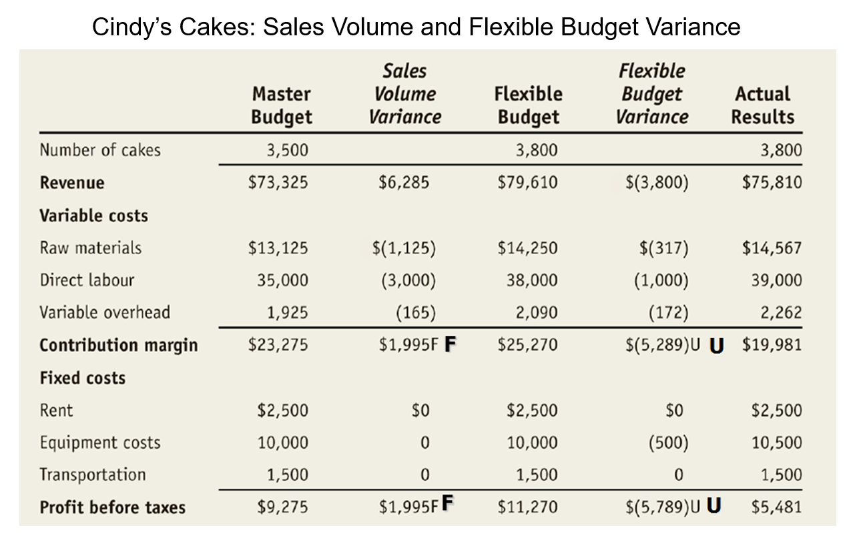
Sales Volume Variance

Slide 67
Sales Volume Variance – In Class Problem
Determine the Sales Volume Variance for Cindy’s Cake
Use the following formula:
Sales Volume Variance
= (Actual Units sold – Budgeted units sold) x Budget Sales Price/ Unit
Sales Volume Variance
= (Actual Units sold – Budgeted units sold) x Budget Sales/ Unit
= (3,800 units – 3,500 units) x $20.95
= $6,285 favourable
Why??
Unfavourable – actual # of units lower than budgeted number sold
Favourable – actual # of units higher than budgeted number sold

Slide 68
Sales Price Variance – In Class Problem
Determine the Sales Price Variance for Cindy’s Cake
Use the following formula:
Sales Price Variance
= (Actual price/ unit– Budgeted price/unit) x Actual Unit Sales
Sales price variance
= (Actual price/ unit – Budget price/unit) x actual unit sales
= ($19.95 - $20.95 ) x 3,800 cakes
= $3,800 unfavourable
Why??
Actual Sales price / cake = Actual Revenue / Actual # of cakes sold
= $75,810 / 3800 cakes
= $19.95
Budget Sales price / cake = Budget Revenue / Actual # of cakes sold
= $79,610 / 3800 cakes
= $20.95

Slide 69
Model for Flexible Variance Analysis
Actual
Results
Flexible Budget
Master Budget
Actual Quantity
×
Actual Price
Actual Quantity
×
Standard Price
Standard Quantity
×
Standard Price
Price Variance
Quantity Variance
A variance could be to a change in quantity or a change in price
Spending Variance
(AQ × AP) – (AQ × SP)
AQ = Actual Quantity AP = Actual Price
(AQ × SP) – (SQ × SP)
SP = Standard Price
SQ = Standard Quantity

Slide 70

Flexible Budget Variances
Price Variance
AQ * (AP-SP)
A = Actual
Q = Quantity P = Price
S = Standard (Budgeted / Standard)
Quantity Variance
SP * (AQ-SQ)
15

Slide 71
Overhead Application in a Standard Costing System
Notice the difference from what we have previously seen.
In a normal cost system, overhead is applied to work in process based on the actual number of hours worked in the period.
In a standard cost system, overhead is applied to work in process based on the standard hours allowed for the actual output of the period.
Normal Costing MOH (T-Account)
Actual OH | Applied OH (Actual Hours * POHR)
Standard Costing MOH (T-Account)
Actual OH | Applied OH (Standard Hours * POHR)

Slide 72
Fixed Overhead Variances
Actual Fixed Overhead Incurred
Fixed Overhead Budget
Fixed Overhead Applied
Denominator Hours * POHR
Standard Hours * POHR
Budget Variance
Volume Variance

Slide 73
Fixed Overhead Variances (cont’d)
Budget Variance
The budget variance is a measure of the difference between the actual fixed overhead costs incurred during the period and the budgeted fixed overhead costs as contained in the flexible budget.
Budget variance = Actual fixed overhead cost – Flexible budget fixed overhead cost
Volume Variance
The volume variance is a measure of utilization of plant facilities.
Fixed portion of the predetermined overhead rate
denominator hours – standard hours allowed
Volume Variance
=
x

Slide 74
Cost Variance – In Class Problem
Example – Cindy’s Cake Shop
total cost variance = Actual cost – budgeted cost
= $70,329 - $64,050
= $6,279 unfavourable
What additional information does management need?

Slide 75
Cost Variance – In Class Problem
The cost variance formula is comprised of 2 elements:
Volume (Quantity) variance
Price variance
Favourable variance – actual cost incurred is lower than expected
Unfavourable variance – actual cost incurred is higher than expected

Slide 76
Quantity Variance – In Class Problem
Variable cost – unit level costs as they vary with the number of units produced
Quantity variance is the difference between the actual usage of something and its expected usage.
Quantity Variance
= (actual quantity used – Standard quantity use ) x Standard cost/ unit

Slide 77
Quantity Variance – In Class Problem
Quantity Variance
= (actual quantity used – Standard quantity use ) x Standard cost/ unit
Quantity Variance Example
Cindy’s Cake Shop budget for 5 eggs (raw material) per cake. The budget price is $.12 / egg. The budget states that they are expected to sell 3,500 cakes. They actually sold 3,800 cakes. They actually used 18,600 eggs.
Calculate the quantity variance for the eggs
Quantity variance for the eggs
= (Actual quantity used – Standard quantity used ) x Standard cost per unit
= (18,600 – 19,000 **) x $.12/ egg
= $48 Favourable
**Flexible Budget = Actual cakes x Standard #units/ cake
= 3,800 cakes x 5 eggs
= 19,000 eggs

Slide 78
Price Variance – In Class Problem
Price Variance
= (actual cost– Standard cost) x Actual units
Price Variance Example
Cindy’s Cake Shop budget for 5 eggs (raw material) per cake. The budget price is $.12 / egg. The budget states that they are expected to sell 3,500 cakes. They actually sold 3,800 cakes. They actually used 18,600 eggs at a cost of $.14 each.
Calculate the price variance for the eggs
Price variance for the eggs
= (Actual cost– Standard cost ) x Actual units
= ($.14- $.12) x 18,600 eggs
= $372 Unfavourable

Slide 79
Why do Variances Occur?
Direct Materials Variances | Direct Labour Variances
Change in quality of material Change in quantity purchased (volume discount) New supplier Better negotiation Drop / increase in price of material | A new union contract Change in average experience or training of workers Change in government regulations Unanticipated overtime
Normal fluctuations in usage Change in production process Change in proportion of spoilage Change in quality of materials Change in equipment & technology Equipment malfunction Theft of material | Change in equipment or technology Change in training and experience of workers Improved performance from training programs Change in employee turnover Intentional or unintentional reporting of labour hours. Unreasonable labour hours standard
PRICE
QUANTITY

Slide 80
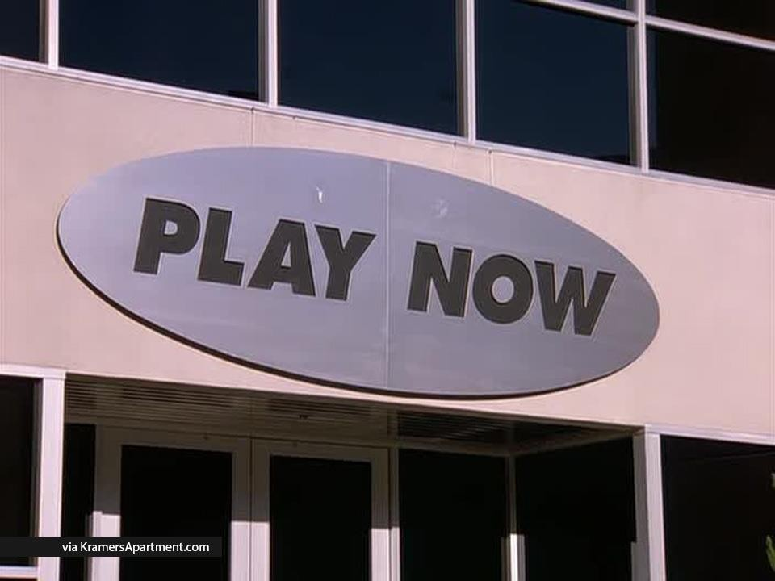
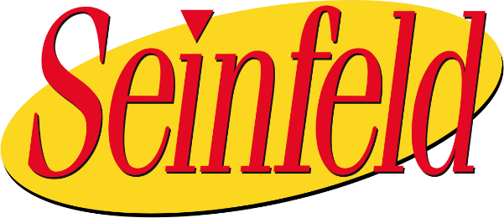
In Class Example
ATS Sports: Analysis of Managers’ Bonuses

Slide 81
ATS Sports: Analysis of Managers’ Bonuses
ATS Sports is a small manufacturing company that produces various sports equipment.
Three separate manufacturing facilities:
East
Southeast
West
Let’s Focus only on East.
Repetitions in the calculations
CEO wants “Amy” (i.e., you) to evaluate the performance of the production managers in each facility and give recommendations about whether the managers should receive bonuses based on their performances.
CEO also wants “Amy” (i.e., you) to evaluate the appropriateness and effectiveness of its ATS newly developed bonus policy.

Slide 82
Let’s Focus only on East.
ATS Sports (cont’d)
Company Background:
Three groups of Products
Summer/Wheel products (bicycles, skateboards, and rollerblades)
Winter products (ice skates, skis, and snowboards)
Water products (canoes, kayaks, and surfboards)
The East facility produces summer or wheel products; the Southeast facility produces winter products; and the West facility produces water products
Four types of managers in each manufacturing facility
Managers are evaluated based on their ability to manage four manufacturing costs: direct materials (DM), direct labor (DL), variable overhead (VOH), and fixed overhead (FOH).

Slide 83
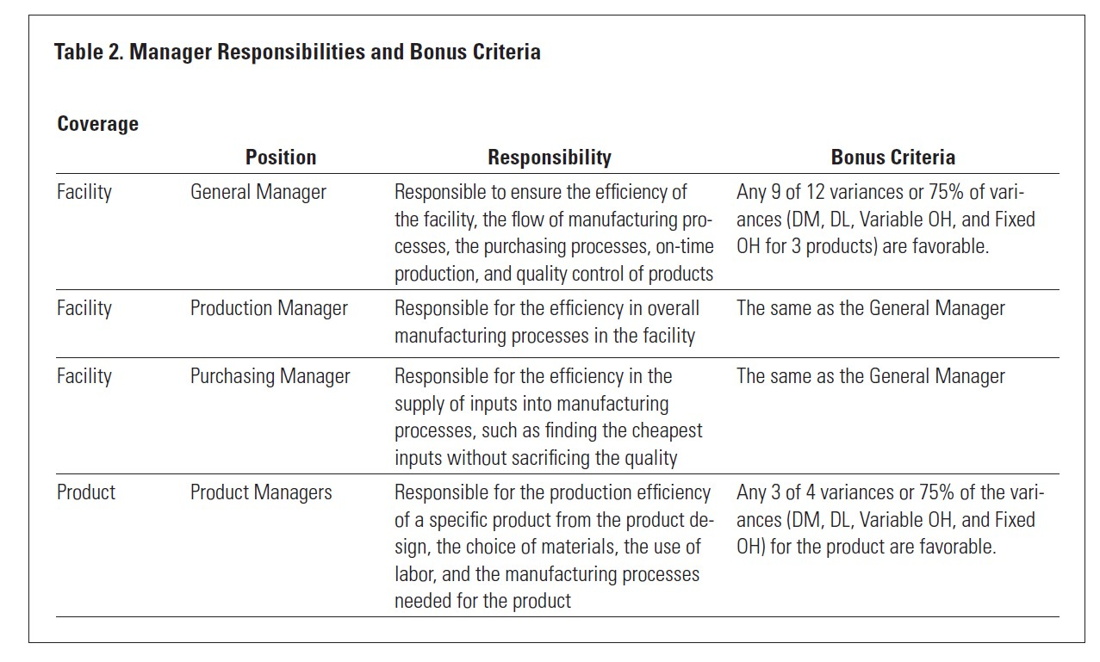
Why not sales?
ATS Sports (cont’d)
What is the incentive?
Do you agree?

Slide 84
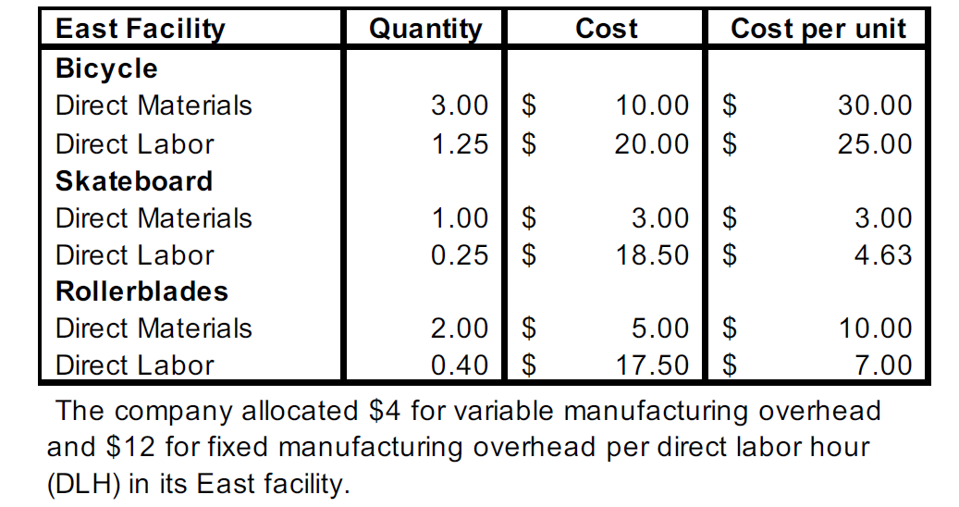
ATS Sports (cont’d)
Standard Costs per Unit (East Facility):

Slide 85
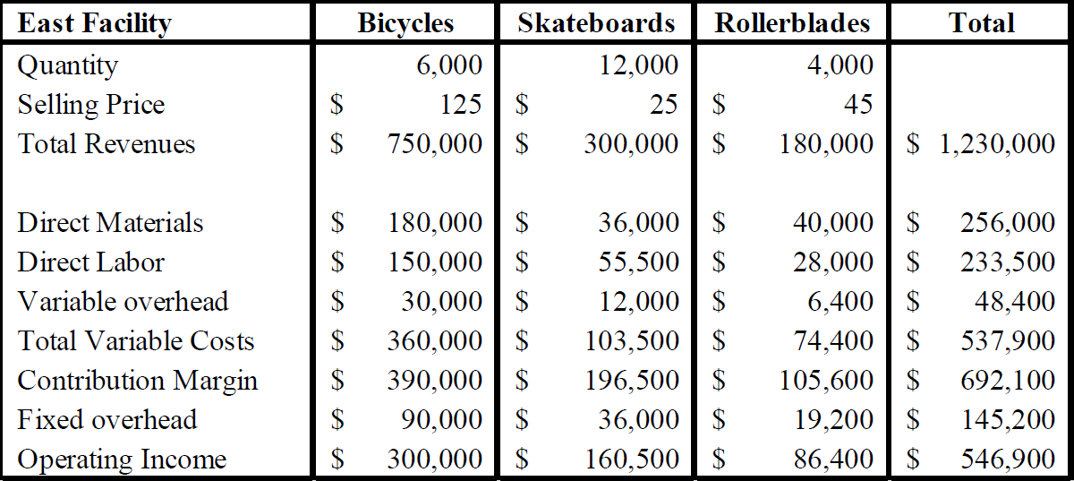
ATS Sports (cont’d)
Original Budget (East Facility):

Slide 86
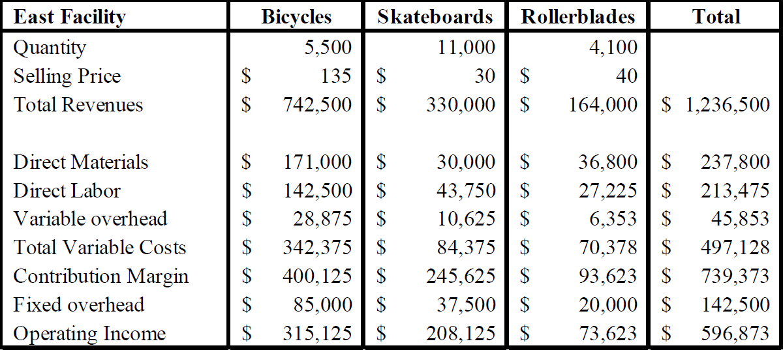
ATS Sports (cont’d)
Notice that Operating Income > Budget. Does that automatically imply good performance?
Actual Performance (East Facility):

Slide 87
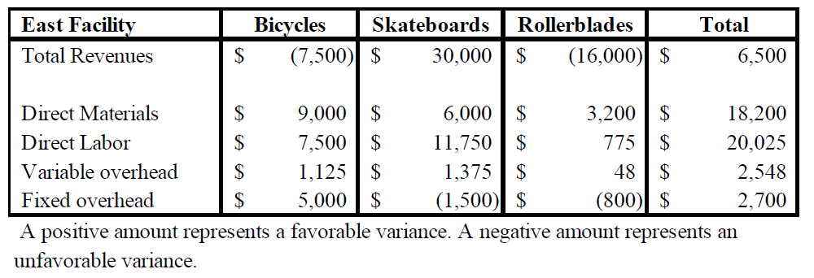
ATS Sports (cont’d)
Chief productions officer Luke Green:
“Since these managers are not responsible for sales, the unfavorable sales variances are
not their responsibilities.”
“It appears all managers performed extremely well, indicated by the number of favorable variances for each facility and product.”

Slide 88
ATS Sports: Results
Product | Static Budget Volume | Actual Sales Volume | Δ
Bicycles | 6,000 | 5,500 | (500)
Skateboards | 12,000 | 11,000 | (1,000)
Rollerblades | 4,000 | 4,100 | 100
Hence, why we need Flex Budgets.
Comparing actual performance to the original budget can be misleading if the company operated at a level different from the original static budget level.

Slide 89
Appears the Management is doing well.
ATS Sports: Results (cont’d)
Bicycles | Original Budget | Actual Performance | Δ
Direct Materials | 180,000 | 171,000 | 9,000 F
Direct Labor | 150,000 | 142,500 | 7,500 F
VMOH | 30,000 | 28,875 | 1,225 F
FMOH | 90,000 | 85,000 | 5,000 F
TOTAL |  |  | 22,725 F

Slide 90
Appears the Management is doing well.
ATS Sports: Results (cont’d)
Skateboards | Original Budget | Actual Performance | Δ
Direct Materials | 36,000 | 30,000 | 6,000 F
Direct Labor | 55,500 | 43,750 | 11,750 F
VMOH | 12,000 | 10,625 | 1,375 F
FMOH | 36,000 | 37,500 | 1,500 U
TOTAL |  |  | 17,625 F

Slide 91
Appears the Management is doing well.
ATS Sports: Results (cont’d)
Rollerblades | Original Budget | Actual Performance | Δ
Direct Materials | 40,000 | 36,800 | 3,200 F
Direct Labor | 28,000 | 27,225 | 775 F
VMOH | 6,400 | 6,353 | 47 F
FMOH | 19,200 | 20,000 | 800 U
TOTAL |  |  | 3,222 F

Slide 92
Flex Budget: Actual Quantity * Standard Price
1. Prepare a Flexible Budget
All driven by Sales.
Bicycles | Quantity |  | Price/Cost per unit | Flex Budget | Actual | Variance | Favourable/ Unfav.
Sales | 5,500 |  | $125 | $687,500 | $742,500 | $55,000 | F
Direct Materials 3pnd @ 10.00 | 5,500 (16,500 lbs) |  | $30 | $165,000 | $171,000 | $6,000 | U
Direct Labour 1.25 hours @ $20 | 5,500 (6,875 hrs) |  | $25 | $137,500 | $142,500 | $5,000 | U
Variable MOH $4.00 per DLH | 5,500 (6,875 hrs) |  | $5 | $27,500 | $28,875 | $1,375 | U
Fixed MOH $12 per DLH | 6,000 |  | $15 | $90,000 | $85,000 | $5,000 | F
 | (7,500 hrs)
Margin |  |  |  | $267,500 | $315,125 | $47,625 | F

Slide 93
2. Compute the Sales Price Variance and Sales Quantity Variance
Bicycles
Sales Price Variance - Bicycle
= (AQ x AP) – (AQ x SP)
= (5,500 * $135) – (5,500 * $125)
= $742,500 - $687,500
= $55,000 F
Where did we see this?
Sales Volume Variance - Bicycle
= (AQ x SP) – (SQ x SP)
= (5,500 * $125) – (6,000 * $125)
= $687,500 - $750,000
= -$62,500 U
Sum = $7,500 U
Look at Actual vs. Budget…

Slide 94
3. Compute the Materials Variance
NNot given in Case. Assume 2.75 lbs @ $11.3057/lb.
Material Price Variance
= (AQ × AP) – (AQ × SP)
= (2.75*5,500 * $11.3057) – (2.75*5,500 * $10)
= $171,000 - $151,250
Case was just interested in total Material Variance.
= $19,750 U
Material Quantity Variance
= (AQ x SP) – (SQ x SP)
= (2.75*5,500 * $10) - (3*5,500 * $10)
= $151,250 - $165,000
Sum = $6,000 U
Look at Flex Budget…
= -$13,750 F

Slide 95
4. Compute the Labour Variance
Not given in Case. Assume 1.5 hrs @ $17.2727/hr
Labour Rate Variance
= (AQ x AP) – (AQ x SP)
= (1.5*5,500 * $17.2727) – (1.5*5,500 * $20)
= $142,500 - $165,000
= -$22,500 F
Labour Efficiency Variance
= (AQ x SP) – (SQ x SP)
= (1.5*5,500 * $20) – (1.25*5,500 * $20)
= $165,000 - $137,500
= $27,500 U
Sum = $5,000 U
Look at Flex Budget…
35

Slide 96
5. Compute the Variable Overhead Variances
Not given in Case. Assume 1.5 hrs @ $3.50/hr
Variable Overhead Spending Variance
= (AQ x AP) – (AQ x SP)
= (1.5*5,500 *3.50) – (1.5*5,500 *4.00)
= $28,875 - $33,000
= -$4,125 F
Variable Overhead Efficiency Variance
= (AQ x SP) – (SQ x SP)
= (1.5*5,500 *4.00) – (1.25*5,500*4.00)
= $33,000 - $27,500
= $5,500 U
Sum = $1,375 U
Look at Flex Budget…

Slide 97
6. Compute the Fixed Overhead Variances
Budget Variance
= Actual Fixed OH – Flexible Budget Fixed OH
= 85,000 – 6,000 units*1.25 hrs/unit* $12/hr
= $85,000 - $90,000
= -$5,000 F
Volume Variance
= Standard FOH Cost per unit * (Budgeted Units Produced – Actual Units)
= ($12*1.25) * (6,000 – 5,500)
= $7,500 U

Slide 98
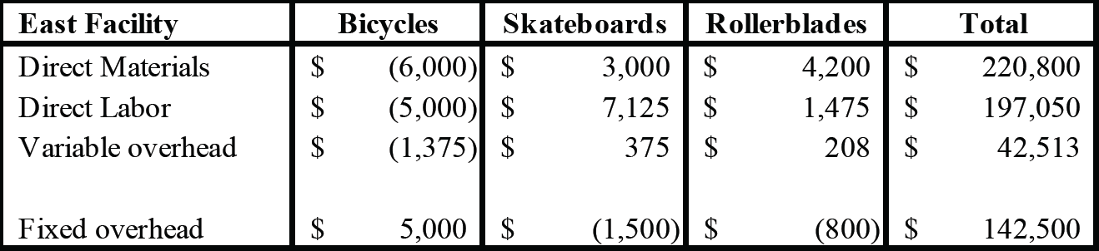
ATS Sports: Cumulative Variances
Much different story.
Not all managers should receive a bonus because they did not meet the requirements for receiving a bonus.

Slide 99
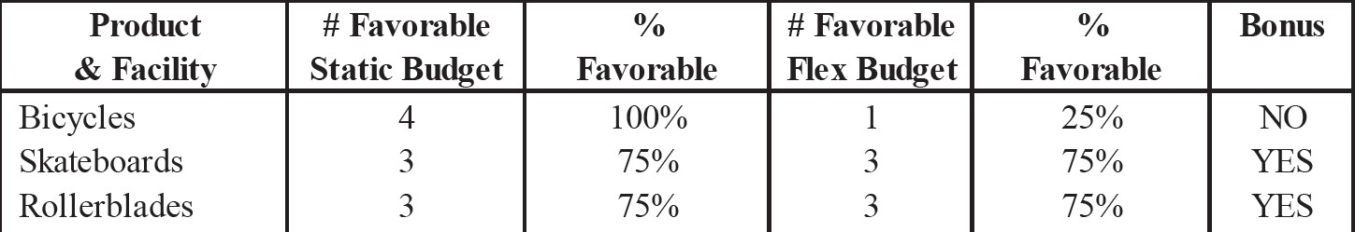
ATS Sports: Results
Bicycle Product Manager should not receive a bonus. Managers did not perform as well as claimed by Luke

Slide 100
Other Considerations
What would be the behavioral impacts of not paying the cash bonus to the managers? How would that affect other employees? How would the decision affect the company’s short-term and longterm profitability as Luke said?
Did the company need a new bonus policy? What recommendations should Amy propose to management regarding the eligibility to receive a bonus?
How should Amy present the complex situation in an effective, yet simple, and
understandable format?

Slide 101
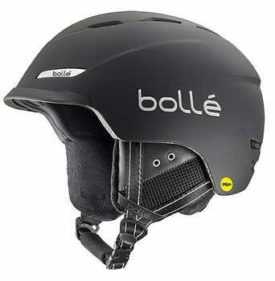
In Class Example
Helmut Pro Inc.
Fun Fact of the Day: It is estimated that there are more than 200 million skiers globally and children account for 13–27% of these participants.

Slide 102
Actual Results
BUDGET |  |  |  | ACTUAL |  |  |  | DIFFERENCE
 | Qty | $ Per unit | Total |  | Qty | $ Per unit | Total
Sales | 65,000 | $ 399 | $ 25,935,000 | Sales | 69200 | $ 382 | $ 26,434,400 | $ 499,400
Direct Materials (3pnd @ 21.50) | 65,000 | $ 65 | $ 4,192,500 | Direct Materials (3.3 pnd @17.90) | 69200 | $ 59 | $ 4,087,644 | -$ 104,856
Direct Labour (4.5 hours @ $21) | 65,000 | $ 95 | $ 6,142,500 | Direct Labour (4.4 hours @ 22.50) | 69200 | $ 99 | $ 6,850,800 | $ 708,300
Variable MOH ($4.20 per DLH) | 65,000 | $ 19 | $ 1,228,500 | Variable MOH (4.25 per DLH) | 69200 | $ 19 | $ 1,294,040 | $ 65,540
Fixed MOH (allocated on the basis of $24.79 per DLH) | 65,000 | $ 25 | $ 7,250,000 | Fixed MOH | 69200 |  | $ 6,785,000 | -$ 465,000
PROFIT |  |  | $ 7,121,500 | PROFIT | $ 7,416,916 |  |  | $ 295,416
Did the company perform well?

Slide 103
Flex Budget: Actual Quantity * Standard Price
1. Prepare a Flexible Budger
Flex Budget | Quantity | Price/Cost per unit | Total | Actual | Variance | Favourable/ Unfav.
Sales | 69,200 | $399 | $27,610,800 | $26,434,400 | -$1,176,400 | U
Direct Materials 3pnd @ 21.50 | 69,200 | $64.50 | $4,463,400 | $4,087,644 | -$375,756 | F
Direct Labour 4.5 hours @ $21 | 69,200 | $94.50 | $6,539,400 | $6,850,800 | $311,400 | U
Variable MOH $4.20 per DLH | 69,200 | $18.90 | $1,307,880 | $1,294,040 | -$13,840 | F
Fixed MOH $24.79 per DLH |  |  | $7,250,000 | $6,785,000 | -$465,000 | F
Margin |  |  | $8,050,120 | $7,416,916 | -$633,204 | U

Slide 104
Compare the Sales Price Variance and Sales Quantity Variance
Sales Price Variance
= (AQ x AP) – (AQ x SP)
= (69,200 * $382) – (69,200 * $399)
= $26,434,400 - $27,610,800
= -1,176,400 U
Where did we see this?
Sales Volume Variance
= (AQ x SP) – (SQ x SP)
= (69,200 * $399) – (65,000 * $399)
= $27,610,800 - $25,935,000
= $1,675,800 F
Sum = $499,400 F
Look at Actual vs. Budget…

Slide 105
3. Compare the Material Varianc e
Material Price Variance
= (AQ × AP) – (AQ × SP)
= (3.3*69,200 * $17.90) – (3.3*69,200 * $21.50)
= $4,087,644 - $4,909,740
= -$822,096 F
Material Quantity Variance
= (AQ x SP) – (SQ x SP)
= (3.3*69,200 * $21.50) - (3*69,200 * $21.50)
= $4,909,740 - $4,463,400
Sum = $375,756 F
Look at Flex Budget…
= $446,340 U
21

Slide 106
4. Compute the Labour Variance
Labour Rate Variance
= (AQ x AP) – (AQ x SP)
= (4.4*69,200 * $22.50) – (4.4*69,200 * $21)
= $6,850,800 - $6,394,080
= $456,720 U
Labour Efficiency Variance
= (AQ x SP) – (SQ x SP)
= (4.4*69,200 * $21) – (4.5*69,200 * $21)
= $6,394,080 - $6,539,400
= -$145,320 F
Sum = $311,400 U
Look at Flex Budget…
22

Slide 107
5. Compute the Variable Overhead Variance
Variable Overhead Spending Variance
= (AQ x AP) – (AQ x SP)
= (4.4*69,200*4.25) – (4.4*69,200*4.20)
= $1,294,040 - $1,278,816
= $15,224 U
Variable Overhead Efficiency Variance
= (AQ x SP) – (SQ x SP)
= (4.4*69,200*4.20) – (4.5*69,200*4.20)
= $1,278,816 - $1,307,880
= -$29,064 F
Sum = $13,840 F
Look at Flex Budget…

Slide 108
Compute the Fixed Overhead Variance
Budget Variance
= Actual Fixed OH – Flexible Budget Fixed OH
= $6,785,000 - $7,250,000
= $465,000 F

Slide 109
Why do Variances Occur?
Remember this?
Direct Materials Variances | Direct Labour Variances
Change in quality of material Change in quantity purchased (volume discount) New supplier Better negociation Drop / increase in price of material | A new union contract Change in average experience or training of workers Change in government regulations Unanticipated overtime
Normal fluctuations in usage Change in production process Change in proportion of spoilage Change in quality of materials Change in equipment & technology Equipment malfunction Theft of material | Change in equipment or technology Change in training and experience of workers Improved performance from training programs Change in employee turnover Intentional or unintentional reporting of labour hours. Unreasonable labour hours standard
PRICE
QUANTITY

Slide 110
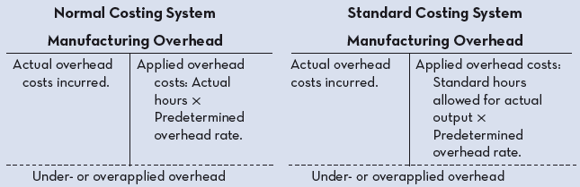
OH Application in Standard Cosing
Notice the difference in Applied OH
Actual vs. Standard

Slide 111
OH Application in Standard Costing (cont’d)
Fixed Manufacturing OH
Actual OH
Dr: Manufacturing OH… Cr: Cash, AP, Supplies…
$140,960
$ 136,800
OH Applied
Each time a unit is produced, we allocate
standard hrs * standard rate
$ 4,160
(3 hrs per unit * $9.5 standard rate * 4800 units)
Dr: WIP…
Cr: Manufacturing OH…
Under Applied

Slide 112
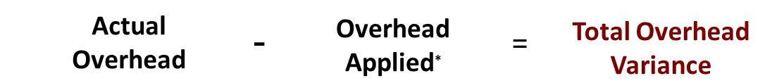
Manufacturing Overhead Variance
Total overhead variance is the difference between actual overhead costs and overhead costs applied to work done.
Computation of actual overhead is comprised of a variable and a fixed component.
Formula for the total overhead variance
In a standard cost system:
Unfavourable variances are equivalent to underapplied overhead.
Favourable variances are equivalent to overapplied overhead.
The sum of the overhead variances equals the under- or overapplied overhead cost for a period.
28

Slide 113
Why Use A Standard Cost System?
Pros:
Helpful to identify variances and implement management by exception.
Management by Exception focuses on identifying and handling cases that deviate from the norm
Can help promote efficiency by setting clear standards for employees.
Can easily integrate responsibility accounting.
Cons:
Variances take time to compute and analyze – risk of information being outdated.
If not used properly (assign blame) – risk of “gameplaying” to cover up variances.
Favorable variances could represent a problem (lower quality of materials…)
Focus on numbers instead and may forget other important objectives.

Slide 114
Any questions?

Slide 115
Thank You!!

